Slide 1
FOOTBALL MATCH PREDICTION USING DEEP LEARNING
By
Naman Jain (2014A7PS0100P)
Vishesh Sharma (2013b4a80195P)
C Hemanth (2014A7PS0075P)

Slide 2
Introduction
Topic of the Paper: Football Match Prediction using Deep Learning
The topic advances on the methodology and technique used to predict the outcome of football matches using RNN and LSTM using a European football dataset.
The thesis uses the concept of sequential input wherein each past output has an influence on the outcome within a match
The order followed will be:
Theory of the concepts used
Formulation of Problem
Preprocessing the data and Feature engineering
Implementation of Code

Slide 3
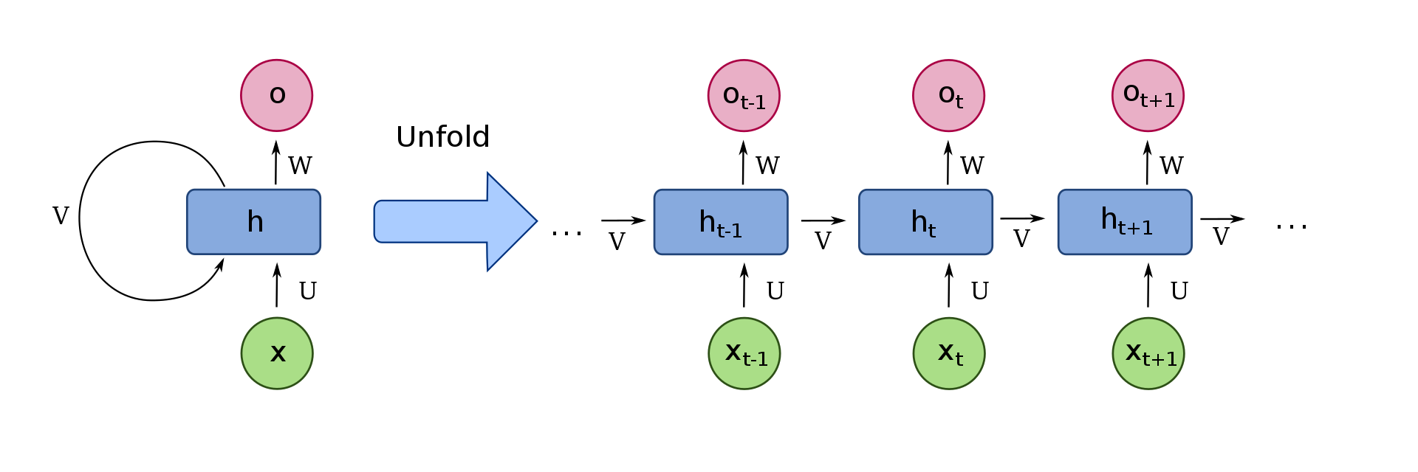
RNN
Recurrent Neural Networks are a class of neural networks where connections between units form a directed graph
It is governed by the concept that the previous inputs have an impact on the next output
The network thus has a temporal memory that it uses to influence the output at a given state

Slide 4
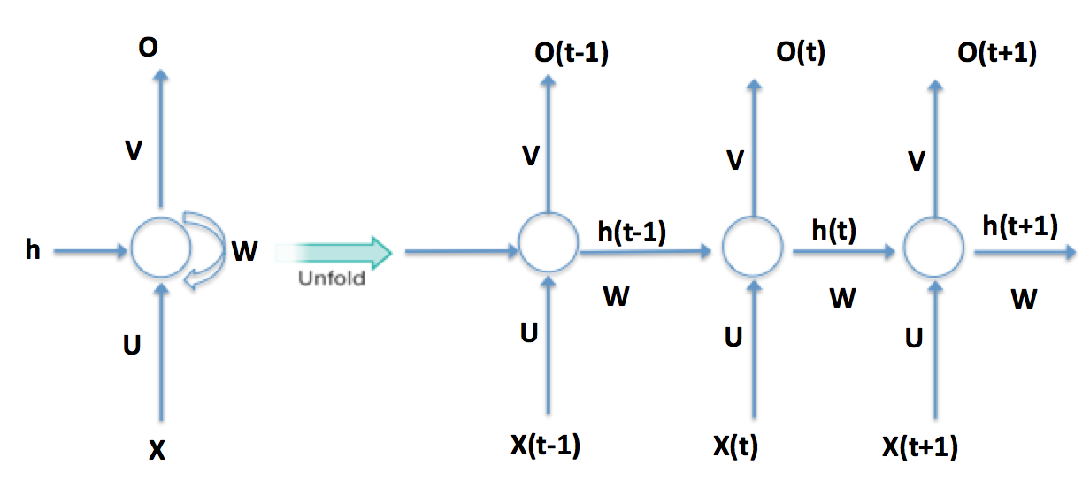

RNN Functioning
The hidden unit of t-1 ( h_t-1) and the input at x_t are combined using weight matrices and then using an activation function give the present h_t
The output at O_t is given from using an activation function on the h_t
Entire forward pass done, then backward pass starts
The weights and biases are updated using backward propagation thereom

Slide 5
RNN Drawbacks
The RNN faces 2 major drawbacks:
1) It is only influenced by the previous inputs and the following inputs ( t+1,t+2 etc)
2) It suffers from exploding gradient and vanishing gradient problem
3) The influence of an input to a much much latter one is very less

Slide 6
LSTM
Long Short Term Memory are a special type of RNN that help solve the vanishing gradient problem and helps us in remembering long term dependencies.
Eg: The cat , who lives next door, walks through the street.
The cats, who live next door, walk through the street.
LSTM makes use of a cell state=c that helps in long term dependencies

Slide 7
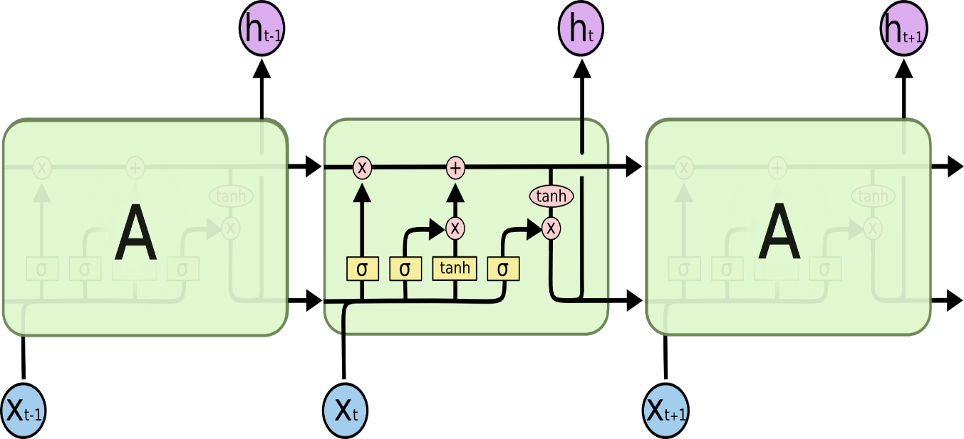
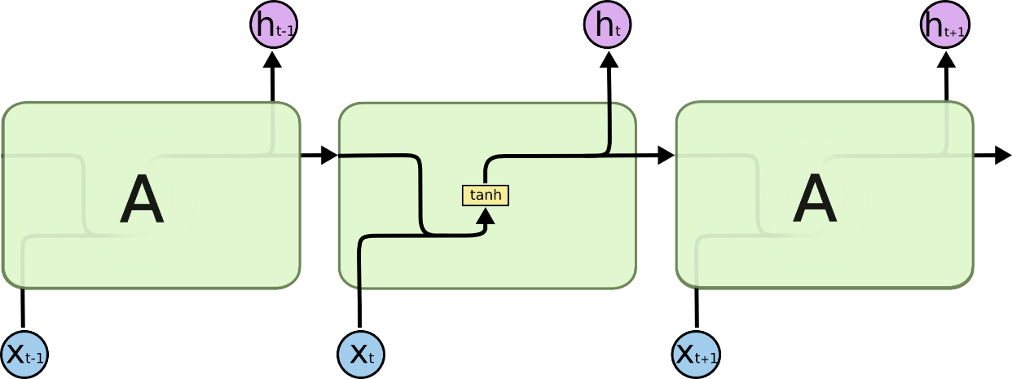
Difference between RNN and LSTM
The architecture below helps us understand the difference between an RNN and an LSTM
LSTM makes use of the update and forget gate which in turn use sigmoid functions to help maintain the “cell state” value to either the previous one or to a new one.

Slide 8
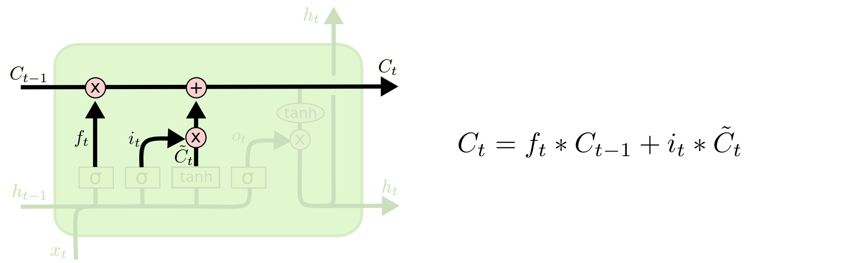
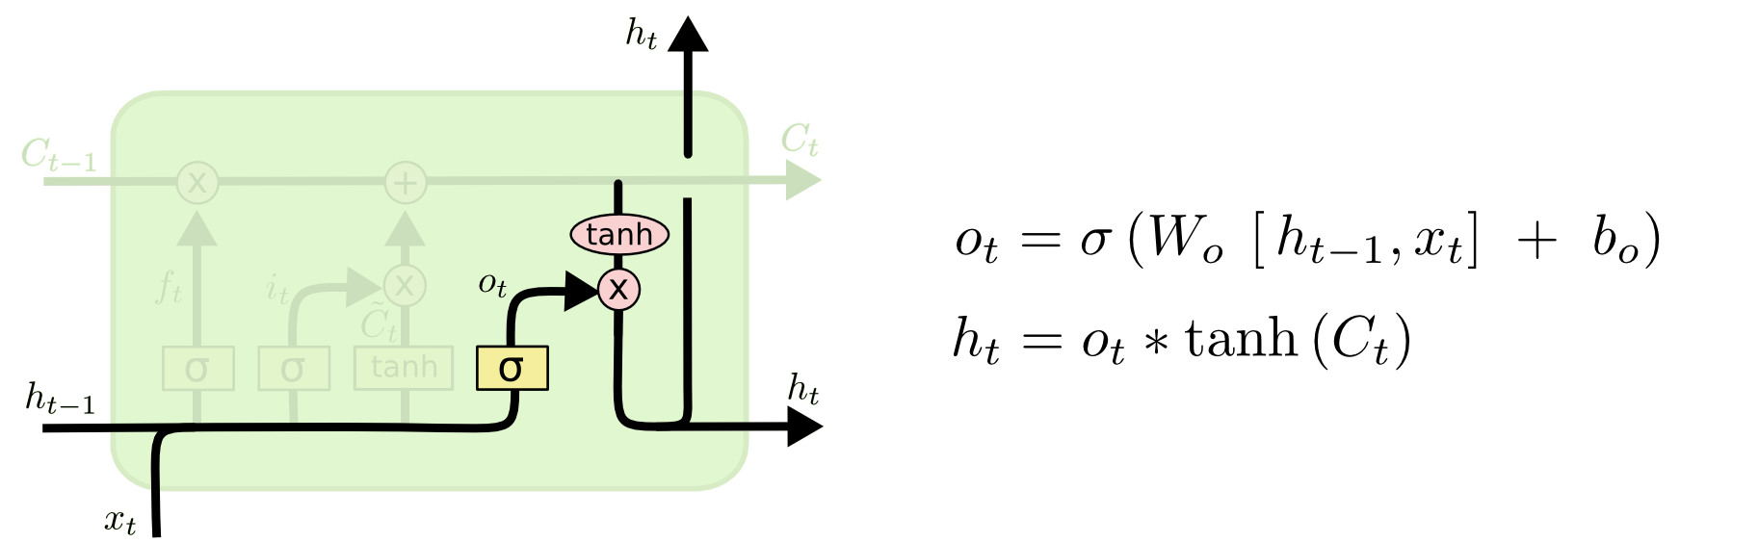
Gates in a LSTM

Slide 9
Objective
To implement and understand in the process, the core algorithms of the deep learning methods of Recurrent Neural Networks (RNN) and Long-Short Term Memory (LSTM), in python, using Tensorflow, Pytorch, MXNet, and/or NumPy; and train the network using a European Soccer Database for Football Events.

Slide 10
Formulation of Problem
In the world of professional football/soccer, many of the matches can be predicted by a human based on the events that particular human has seen in the game so far. It is nearly impossible for a team to cover up a 7-1 deficit with only five minutes to spare, and this can be predicted by a human being.
A computer can be programmed to detect and predict the same thing based on the events that have happened so far in the game, similar to a human brain.
Based on our knowledge of Neural Networks, the problem must be tackled using an architecture that can handle sequential data about the same object of interest, over a period of time.

Slide 11
Source of Data
The data is taken from a public of dataset called football_events, of over 500 matches, with each match having around 100-180 events during the match.
Each event within the match is sequentially fed into the Neural Network and the final result is predicted as a vector of the probabilities for Side 1 Win, Side 2 Win, and Draw.
Data Preprocessing: Certain classifications of the data have been grouped together into singular classifications as they all had the same impact on the game despite having semantic differences.
For example, a second yellow card and a red card have been grouped together as they both have the same effect on the game. And columns like a event_type2 have been dropped as they only pander to a fan’s knowledge as to the exact play-by-play of the events, but do not add anything to the prediction beyond the event_type.
The data is processed according to the chronological series of events in the match.
Reference to original dataset: https://www.kaggle.com/secareanualin/football-events

Slide 12
Source of Data
Feature Mapping:
event_type_mod
0 Announcement
1 Attempt
3 Foul
4 Yellow card
6 Red card
7 Substitution
11 Penalty conceded
side
1 Home
2 Away
is_goal
0 No
1 Yes

Slide 13
Source of Data
Feature Mapping(contd):
shot_outcome_mod
1 On target
2 Off target
location_mod
1 Attacking half/Left wing/Right wing
2 Defensive half
3 Centre of the box/Left side of the box/Right side of the box
6 Difficult angle and long range/Difficult angle on the left or right
13 Very close range/Penalty spot/Around side of the six yard box
15 Outside the box/Long range/More than 35 yards
assist_method
0 None
1 Pass
2 Cross
3 Headed pass
4 Through ball
Result
0 Draw
1 Side 1 Wins
2 Side 2 Wins

Slide 14
Software Package/Platform Used
We have written the code in python, with NumPy and Tensorflow to preprocess the data, and perform the training and testing of the Recurrent Neural Network (RNN) and the Long-Short Term Memory (LSTM).
We have used Comma-Separated Values (CSV) files to store the training and testing data for its simplicity of storage and ease of usability with python and the necessary libraries.

Slide 15
Pseudo Code of the Program
Input Data:
Filename=‘dir_path’
Rows=csv_reader(filename)
Training_data = 1st four hundred matches
Testing_data = next 100 matches
RNN_Hidden=180 (hidden lstm cells)
Learning_rate=0.001
N_input = 8
N_output=1
Epoch =10
Dropout=tf.constant(0.5)
Variable Declare:
Weight, bias = tf.Variables
Inp_X, out_Y = tf.placeholders for input and output
Cell = dropout(tf.contrib.rnn.LSTMCell)
Val,state=tf.nn.dynamic_rnn
Prediction=softmax(matmul(val, weights)+bias)
Cross_entropy error: from prediction, out_Y
Execution:
for I in range(epoch)
for j in range(400)
Inp,out = each match data
Sess.run(minimize cross entropy error)

Slide 16
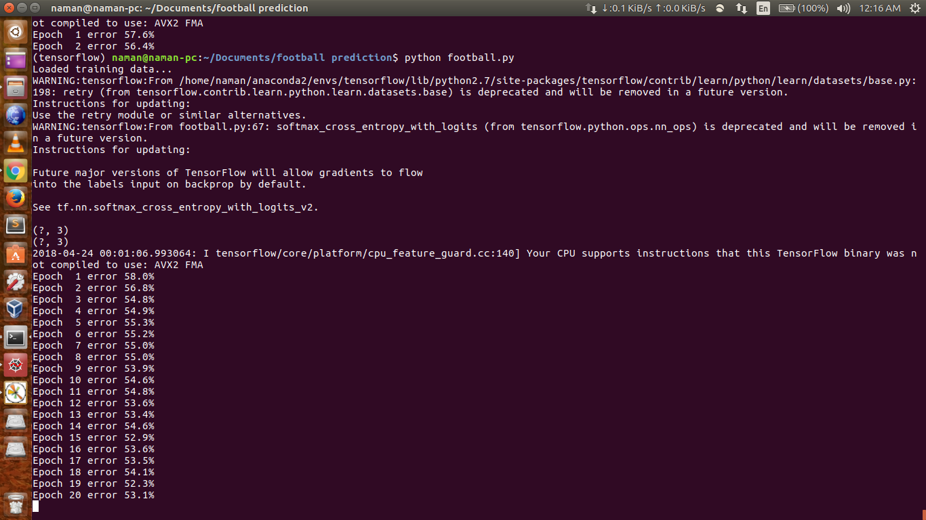
Results

Slide 17
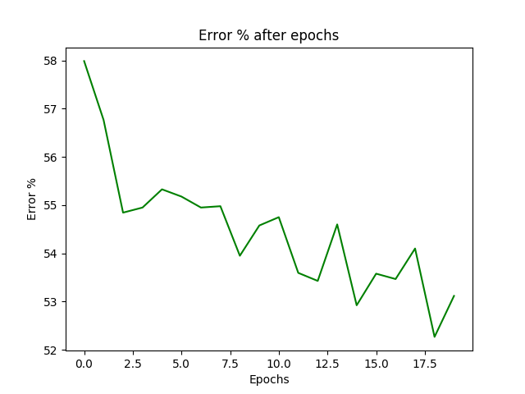
Results

Slide 18
Conclusions
We have learned how to develop and implement Recurrent Neural Networks (RNN), Long-Short Term Memory (LSTM), and how they can be used to predict the outcome on an ongoing football/soccer match based on the events that happened so far in the match.
With more relevant data, we could’ve added to the prediction, the player and team information to have an initial prediction along with its changing prediction during the match.

